Slide 1
Python Machine Learning In Biology:
Ensemble Methods
Nichole Bennett

Slide 2
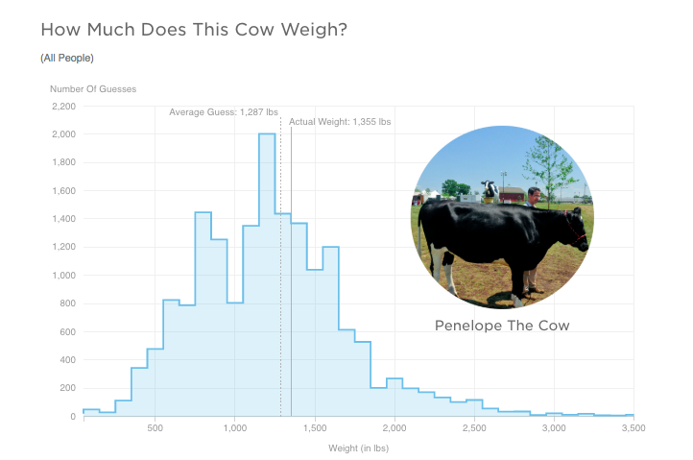
Notes:
NPR asked a bunch of people how much this cow weighed
Among all the people in our poll, the average guess was 1,287 pounds. Penelope weighed 1,355 pounds. So the average was only off by 68 pounds (about 5 percent). Interestingly, the crowd was kind of split: people either thought Penelope weighed between 850 and 950 pounds or they thought she weighed between 1,250 and 1,350 pounds.

Slide 3

The Netflix Prize
https://www.wired.com/2009/09/how-the-netflix-prize-was-won/
Notes:
But they don’t use it! Too computationally complex

Slide 4
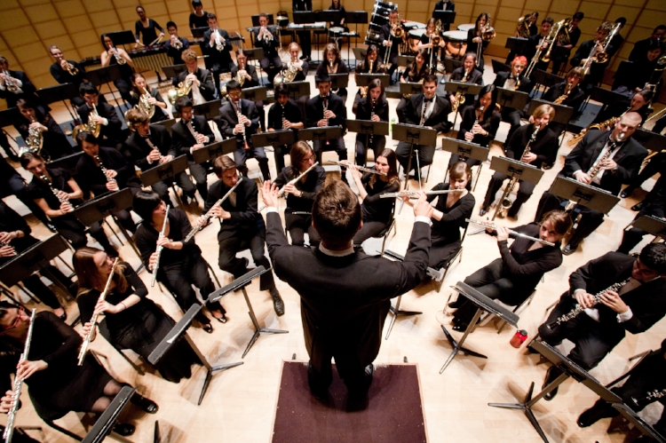
What is an ensemble?

Slide 5
What is an ensemble?
Combine several base classifier models
Often better performance and generalizability than the base models that make them up
Disadvantage is that we lose transparency
Notes:
When might this be most useful?

Slide 6
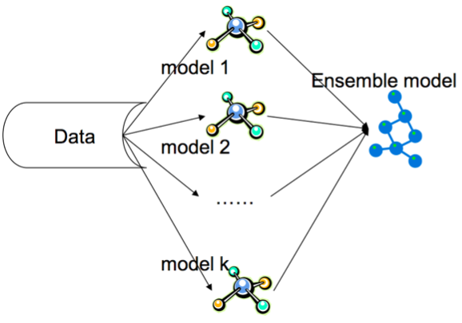
When will this be useful?

Slide 7
Averaging Methods
Build several models and then average their predictors
Reduces variance
Bagging
Random Forests

Slide 8
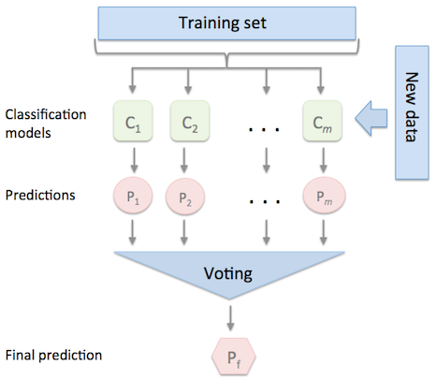
Majority voting methods

Slide 9
Boosting Methods
Building base models sequentially to reduce bias
AdaBoost
Gradient Tree Boosting
We’ll come back to this in a bit

Slide 10
Bagging and Boosting
Bagging aims to reduce variance
Boosting aims to reduce bias (and some variance)

Slide 11
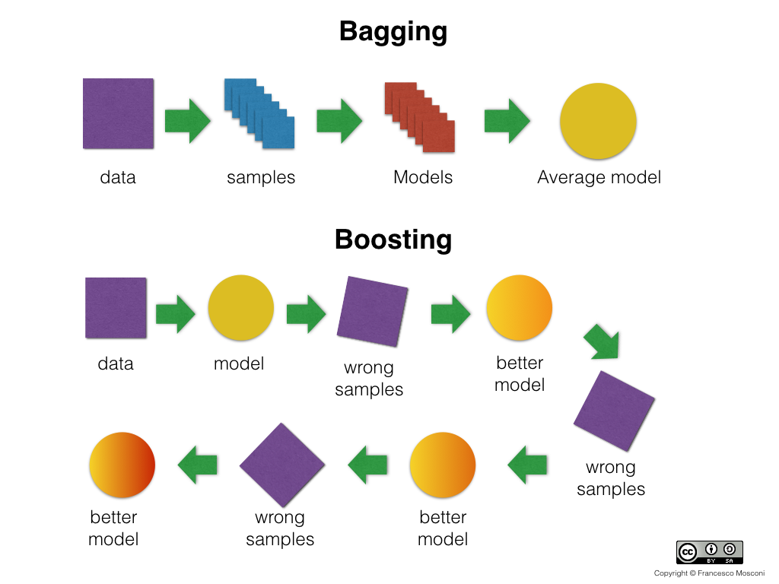

Slide 12
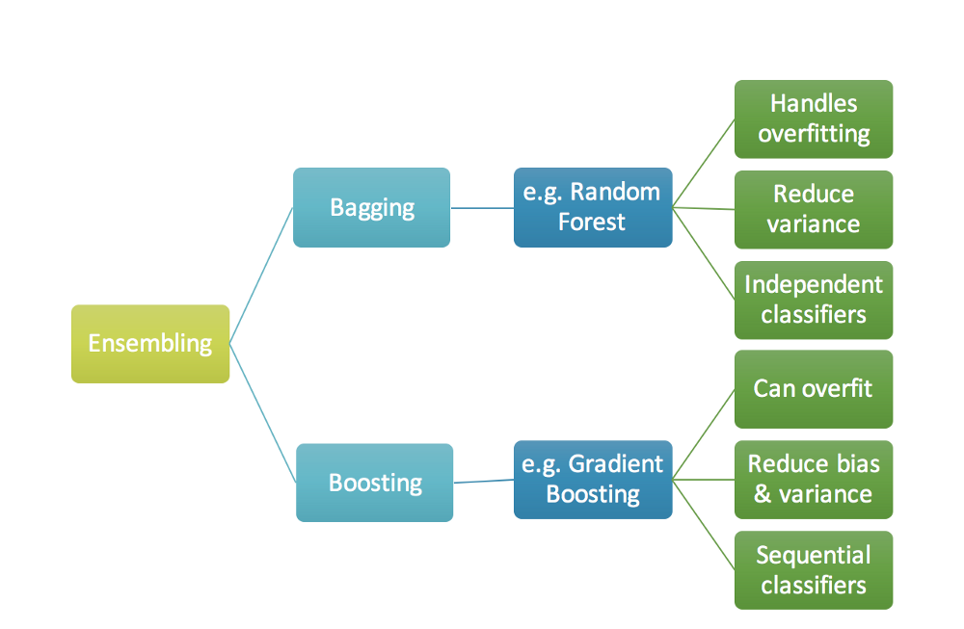

Slide 13
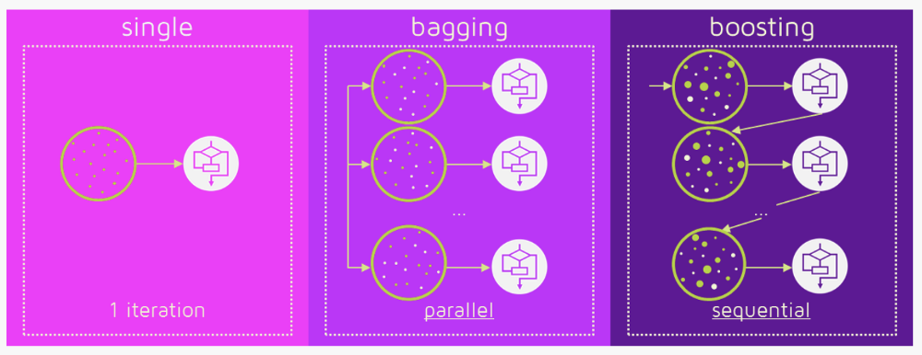

Slide 14
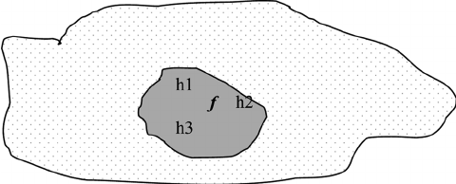
Statistical Problem
If we have a limited amount of training data, classifier will have difficulty converging within our entire hypothesis space.
The true function f is found by “averaging out” the base classifiers.

Slide 15
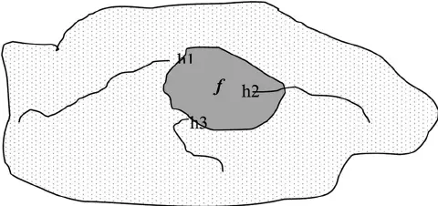
Computational Problem
Even if we have enough training data, it still may be computationally difficult to find the best classifier.
Exhaustive search of all of hypothesis space is complex.
Base classifiers with different starting points give us a better approximation to f

Slide 16
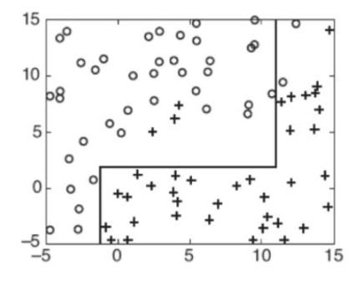
Representational Problem
Sometimes f can’t be explained in terms of our hypothesis space at all.
If we have a decision tree as our base classifier, it will form a rectinlear partition around our feature space.
But what if f is a diagonal line? We won’t be able to get there with finitely many rectangles.
Ensemble methods will help us better approximate a line.

Slide 17
When to use an ensemble model?
For an ensemble model to outperform a single baseline classifier,
Accuracy: baseline classifier must be better than random guessing
Diversity: misclassification must occur on different training sets (baseline models must be wrong in different ways)

Slide 18
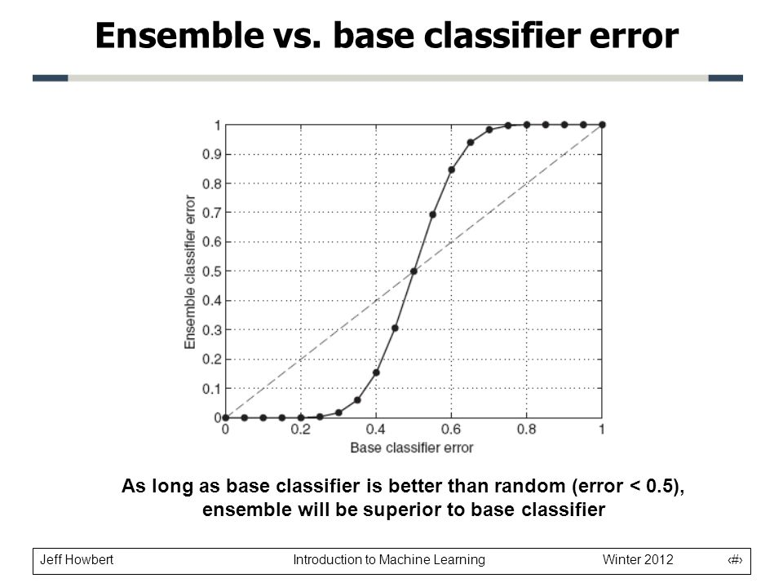
Ensemble vs. base classifier error
Notes:
As long as base classifier is better than random, ensemble will be better

Slide 19
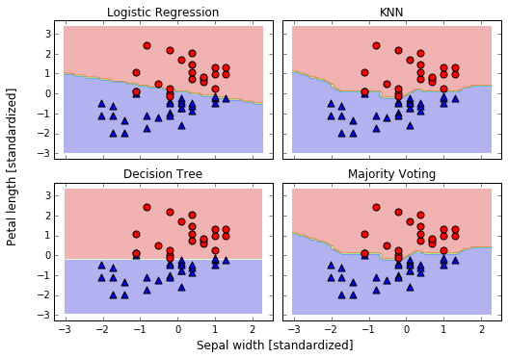

Slide 20
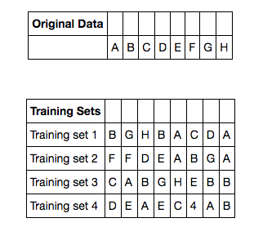
Bagging (Bootstrap Aggregating)
Ensemble method where we resample the training set (randomly drawn subsets)
Creates samples with uniform weights
Then train these samples.
Random Forests are a special case of bagging which also use random feature subsets to fit the individual decision trees)

Slide 21
Bagging
Reduces variance
Less susceptible to overfitting with noisy data
Most of the error is from bias
Best for strong and complex models (well-developed decision trees)
For weak models (shallow decision trees), boosting is a better method

Slide 22
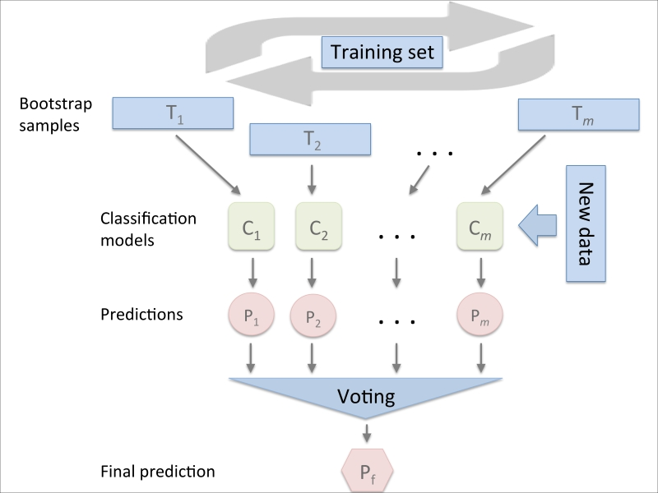

Slide 23
Random Forests
What was the main disadvantage of Decision Trees?
Random forests average multiple deep decision trees
Each trained on a different part of the same training set (bagging)
Reduces variance
Comes at the cost of increasing bias and losing interpretability

Slide 24


Slide 25
Random Forests vs. Bagging Decision Trees
Feature Bagging: At each candidate split in the learning process selects a random subset of the features.
Ordinary bootstrap samples can become correlated. If one or a few of the features are strong predictors, they’ll be selected in many of the base trees. You’ll end up with a lot of the same base predictors.
For a problem with p features, it is typical to use:
p^(1/2) (rounded down) features in each split for a classification problem.

Slide 26
Pros and Cons of Random Forests
Pros
Widely used
Excellent prediction performance
Doesn’t need careful normalization of features or lots of hyperparameter tuning
Handles a mixture of feature types (like decision trees)
Easily parallelized
Cons
Models are difficult for humans to interpret
May not be a good choice for high-dimensional tasks (e.g. fast linear methods may be better for something like text classification)

Slide 27
Boosting
With bagging and random forests we train models on separate subsets and then combine their prediction--parallelizing the training and then combining.
Boosting is a different ensemble technique that is sequential.
Uses weak learners as base models
Each weak learner has low variance and high bias (only slightly better than random guessing--e.g. decision tree stump)
Focuses on the samples that are hard to classify.

Slide 28
Boosting
Draw a random subset of training samples (d₁) without replacement from the training set (D) to train a weak learner (C₁)
Draw a second random training subset (d₂) without replacement from the training set and add 50% of the samples that were previously misclassified to train a weak learner (C₂)
Find the training samples (d₃) in the training set (D) on which C₁ and C₂ disagree to train a weak learner C₃.
Combine the weak learners (C₁, C₂, and C₃) with majority voting.

Slide 29
Boosting
Since the base classifier's focus more and more closely on records that are difficult to classify as the sequence of iterations progresses, they are faced with progressively more difficult learning problems.
Boosting takes a base weak learner and tries to make it a strong learner by re-training it on the misclassified samples.
There are several algorithms for boosting. AdaBoost and GradientBoostingClassifier are in scikit learn.

Slide 30
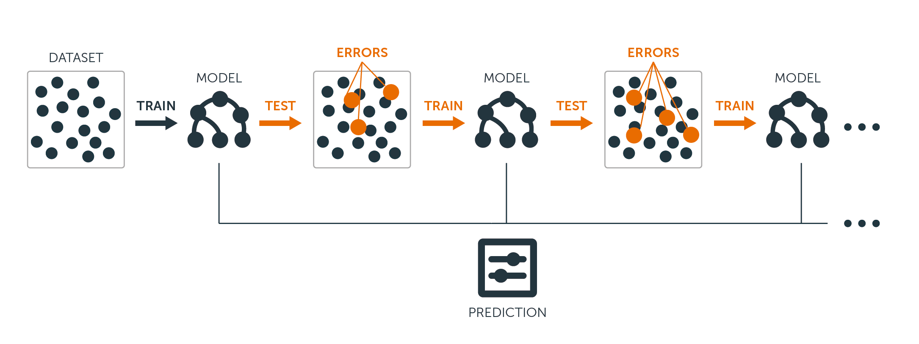
Gradient Boosted Trees
Build a series of small decision trees
Each tree tries to correct the errors from previous stage
Learning rate controls how hard each tree tries to correct remaining mistakes from previous round
High learning rate: more complex tree
Low learning rate: simpler trees

Slide 31
Gradient Boosting
Fit a model F to the data.
Look at the difference between our observed y and our model F. (residuals)
Fit a second model F₂ to (roughly) the residuals.
Aggregate your model F and F₂.
We can interpret residuals as negative gradients. By doing this, we can apply our gradient descent algorithm to optimize our loss and generalize this to many loss functions.

Slide 32
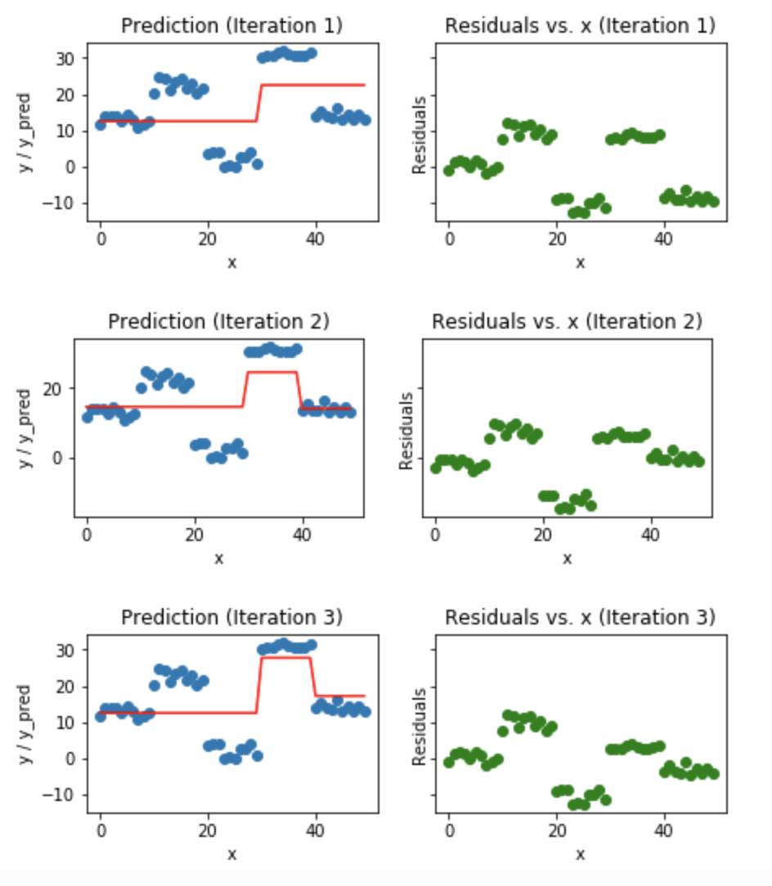
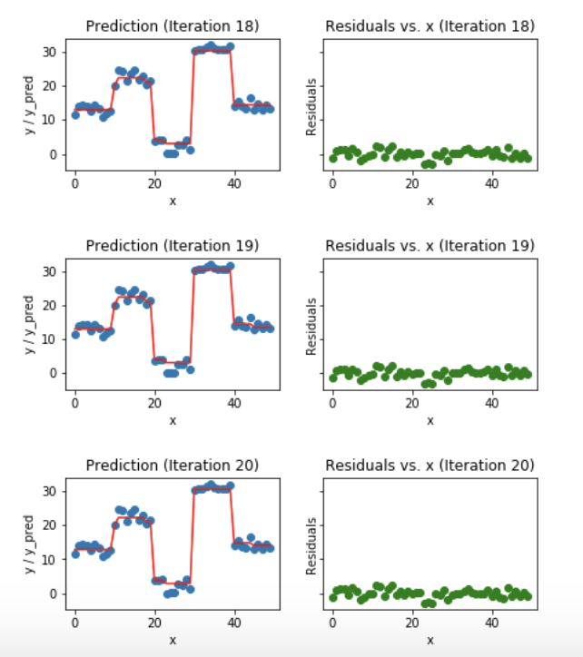

Slide 33
Pros and Cons of Gradient Boosting
Pros
Achieves higher performance than bagging when hyper-parameters tuned properly.
Can be used for classification and regression equally well.
Easily handles mixed data types.
Doesn’t require normalization.
Can use "robust" loss functions that make the model resistant to outliers.
Cons
Difficult and time consuming to properly tune hyper-parameters.
Cannot be parallelized like bagging (bad scalability when huge amounts of data).
More risk of overfitting compared to bagging.
Hard to interpret.
Not recommended for high-dimensional data.
Notes:
Parameters:
n_estimators: sets number of decision trees to use (weak learners) in ensemble
learning_rate: controls emphasis on fixing errors from previous iteration
(above two are usually tuned together)
n_estimators: number of trees to fit, usually set this first
max_depth: usually set to a small value (3-5) for most applications

